Slide 1
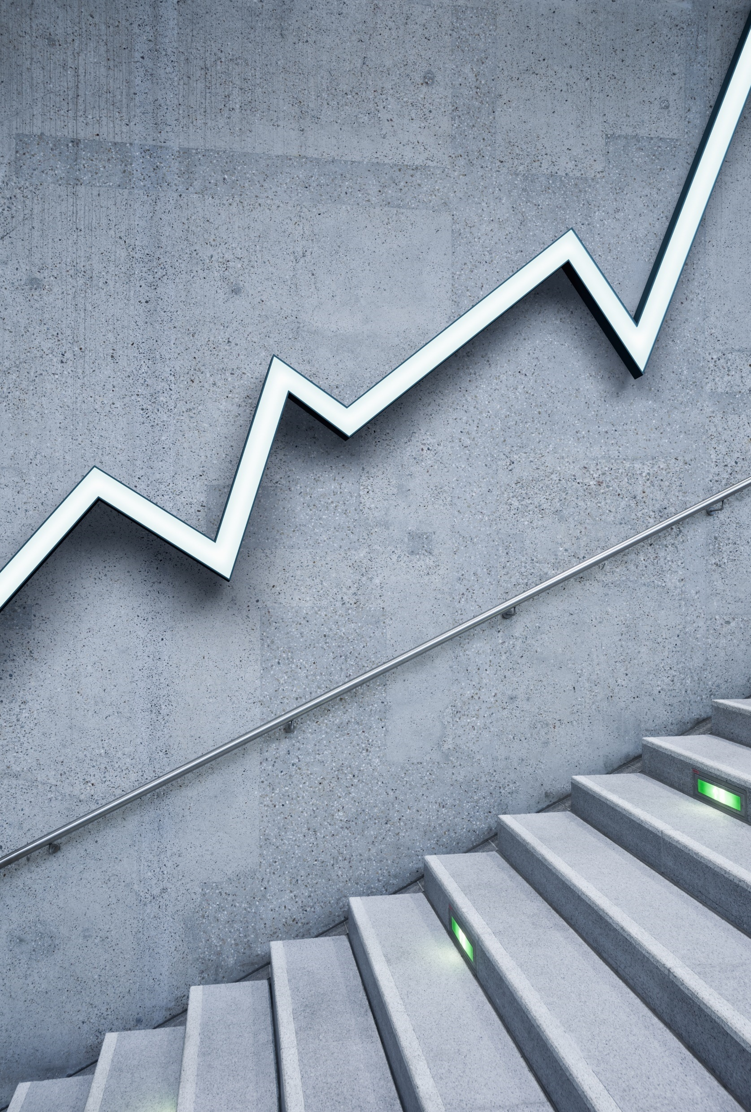
Bitcoin Market Sentiment vs Trader Performance Analysis
Oindrila Chatterjee Project

Slide 2
The main objective of this project is to understand how market sentiment (fear and greed) affects trader behavior and performance. In simple terms, I tried to analyze whether traders earn more profit during greedy market conditions or fearful situations, and how their risk-taking behavior changes accordingl
OBJECTIVE

Slide 3
For this project, I used two datasets: Bitcoin Fear and Greed Index dataset This dataset shows whether the market is in a state of fear or greed on a particular date Historical Trader Data This dataset includes details like profit/loss (PnL), leverage used, and trading activity Both datasets were combined using the date column to perform analysis
DATASET USED

Slide 4
First, I cleaned both datasets and ensured the date format was consistent. Then, I merged the datasets using the common date column so that each trade could be linked with the market sentiment of that day. After merging, I created additional columns such as profit/loss category to simplify the analysis. Finally, I performed grouping and aggregation to identify patterns and trends.
METHODOLOGY

Slide 5
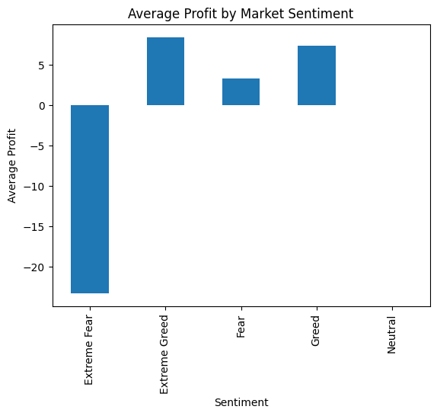
From the analysis, it is clear that average profits are higher during greed periods compared to fear periods. This suggests that traders benefit more when the market is optimistic and prices are rising.
classification Fear 50 Extreme Greed 46 Greed 33 Neutral 8 Extreme Fear 7 Name: count, dtype: int64
PROFIT VS SENTIMENT

Slide 6
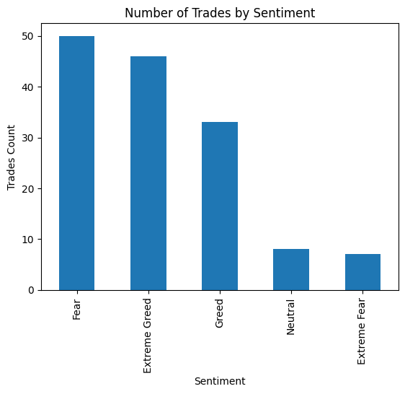
The number of trades is noticeably higher during greed phases. This indicates that traders are more active and confident when the market sentiment is positive. On the other hand, during fear periods, trading activity reduces significantly.
classification Fear 50 Extreme Greed 46 Greed 33 Neutral 8 Extreme Fear 7 Name: count, dtype: int64
TRADING ACTIVITY

Slide 7
The average leverage used by traders is higher during greed periods. This shows that traders are willing to take higher risks when they expect the market to go up. In contrast, during fear periods, traders tend to be more cautious and reduce their risk exposure
LEVARAGE ANALYSIS

Slide 8
Traders tend to earn higher profits during greed phases.
Market optimism leads to increased trading activity.
Traders use higher leverage in greedy market conditions, indicating higher risk-taking behavior.
Fear phases are associated with lower profits and reduced trading activity.
KEY INSIGHTS

Slide 9
From this analysis, it can be concluded that market sentiment plays a very important role in trading behavior. Greed phases encourage traders to take more risks, resulting in higher profits but also increased volatility. Fear phases, on the other hand, lead to cautious behavior, lower participation, and reduced profitability. Overall, understanding market sentiment can help traders make more informed decisions
CONCLUSION

Slide 10
This project helped me understand how data analysis can be used to study real-world financial behavior. It also showed how psychological factors like fear and greed directly impact trading decisions and outcomes.
FINAL NOTE

